Slide 1


Gujarat Technological University
NEW L. J. INSTITUTE OF ENGINEERING AND TECHNOLOGY
DEPARTMENT OF CSE(AIML), CSE OR IT
ACADEMIC YEAR – 2026
Internship (3180701)
Codeverse
PREPARED BY,
STUDENT NAME:
Akbari Nihar Brijeshbhai
ENROLLMENT NUMBER:
221430142001
HOD NAME:
Gayatri Pandi
CSE(AIML)&IT,
NEW LJIET.
GUIDED BY,
GUIDE NAME:
Ms. Neha Pujara
SEMESTER: DEPARTMENT OF INFORMATION TECHNOLOGY

Slide 2
Outline
ABSTRACT
PROBLEMS IN EXISTING SYSTEM
PURPOSE OF THE PROJECT
FUNCTION REQUIREMENTS
SYSTEM MODULES
SYSTEM REQUIREMENTS
FRONT END AND BACK END OF SYSTEM
DATA DICTIONARY
SNAPSHOT OF WEBSITE
FUTURE ENHANCEMENT

Slide 3
ABSTRACT
The CodeVerse Online Hackathon Platform is a web-based system for conducting hackathons on a centralized platform. It allows organizations to create events, and participants to register, form teams, and submit projects.
Organizers manage problem statements, rules, and timelines, and to ensure fair results. Participants can track their progress, scores, and rankings in real time. judges evaluate submissions to ensure fair results. Participants can track their progress, scores, and rankings in real time.
The platform automates the entire hackathon process, reduces manual work, and promotes innovation, collaboration, and competitive learning.

Slide 4
2. PROBLEMS IN EXISTING SYSTEM
Hackathons managed manually
Difficult participant coordination
No centralized submission system
Unstructured judging process
Lack of transparency in results
Communication gaps during events

Slide 5
3. PURPOSE OF THE PROJECT
Create centralized hackathon platform
Simplify registration & team formation
Manage submissions digitally
Ensure fair evaluation process
Promote innovation & collaboration

Slide 6
4. FUNCTION REQUIREMENTS
User registration and login
Hackathon creation & management
Team formation system
Problem statement upload
Project submission module
Judge scoring & feedback
Leaderboard & results
Notifications & updates

Slide 7
5. SYSTEM MODULES
Admin Module
Create & manage hackathons
Approve organizers & Judges
Monitor platform activity
Generate Reports
Manage System settings
Participant Module
Register for hackathons
Form or join teams
View problem statements
Submit projects/solutions
Track results and status
Organizer Module
Create hackathon events
Define rules & timelines
Upload problem statements
Assign judges
Track participant progress
Judge Module
Review project submissions
Evaluate using criteria
Provide scores & feedback
Ensure fair assessment

Slide 8
6. SYSTEM REQUIREMENTS
Hardware Requirements
Processor: Intel i3 or higher
RAM: Minimum 4 GB
Storage: 50 GB
Software Requirements
Operating System: Windows / Linux
Programming Language: Java
Framework: Spring Boot
Database: MySQL
Web Browser: Chrome / Edge
Version Control: Git

Slide 9
7. FRONT END AND BACK END OF SYSTEM
Frontend Technologies
HTML
CSS
JavaScript
Bootstrap
Backend Technologies
Spring Boot (Java Web Framework)
Hibernate (JPA – ORM Tool)
MySQL (Database)

Slide 10
8. DATA DICTIONARY
user_types
Field Name | Data type (size) | Constraint | Description
user_id | BIGINT | Primary key, Auto Increment | Stores the unique identifier of the user.
first_name | Varchar(100) | Not Null | User’s first name
last_name | Varchar(100) | Not Null | User’s last name
email | Varchar(150) | Not Null, Unique | User’s email
password | Varchar(255) | Not Null | Encrypted password
role | VARCHAR(30) | NOT NULL | Role label
profile_pic_url | VARCHAR(500) | NULL | Profile image url
active | BOOLEAN | NOT NULL | Account Status
otp | VARCHAR(10) | NULL | OTP for password reset
user_type_id | BIGINT | FK -> user_types.user_type_id | Role reference

Slide 11
Cont…
hackathons
Field Name | Data type (size) | Constraint | Description
hackathon_id | BIGINT | PK, Auto Increment | Unique hackathon id
title | VARCHAR(200) | NOT NULL | Hackathon Title
description | TEXT | NOT NULL | Event description
status | VARCHAR(30) | NOT NULL | UPCOMING/ONGOING/COMPLETED
event_type | VARCHAR(30) | NOT NULL | ONLINE/OFFLINE/HYBRID
payment | VARCHAR(30) | NOT NULL | FREE/PAID
location | VARCHAR(200) | NULL | Event location
registration_start_date | DATE | NOT NULL | Registration start
registration_end_date | DATE | NOT NULL | Registration end
min_team_size | INT | NOT NULL | Minimum team members
max_team_size | INT | NOT NULL | Maximum team members
user_id | BIGINT | FK -> users.user_id | Organizer id
category_id | BIGINT | FK -> categories.category_id | Category id

Slide 12
Cont…
user_type
Field Name | Data type (size) | Constraint | Description
user_type_id | BIGINT | Primary key, Auto Increment | Unique role id
user_type | Varchar(30) | Not Null, Unique | Role Name (ADMIN/ORGANIZER/PARTICIPANT/JUDE)

Slide 13
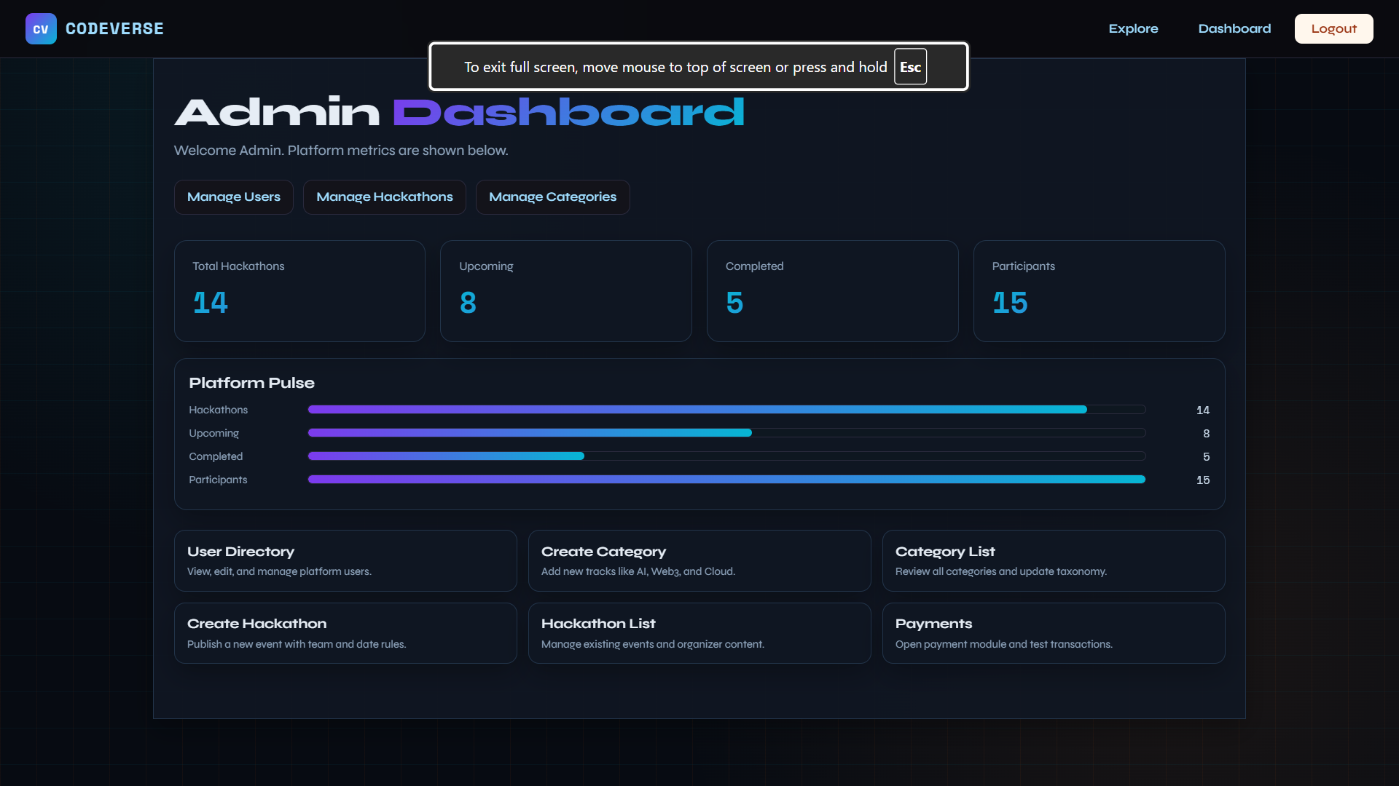
8. SNAPSHOTS OF WEBSITE

Slide 14
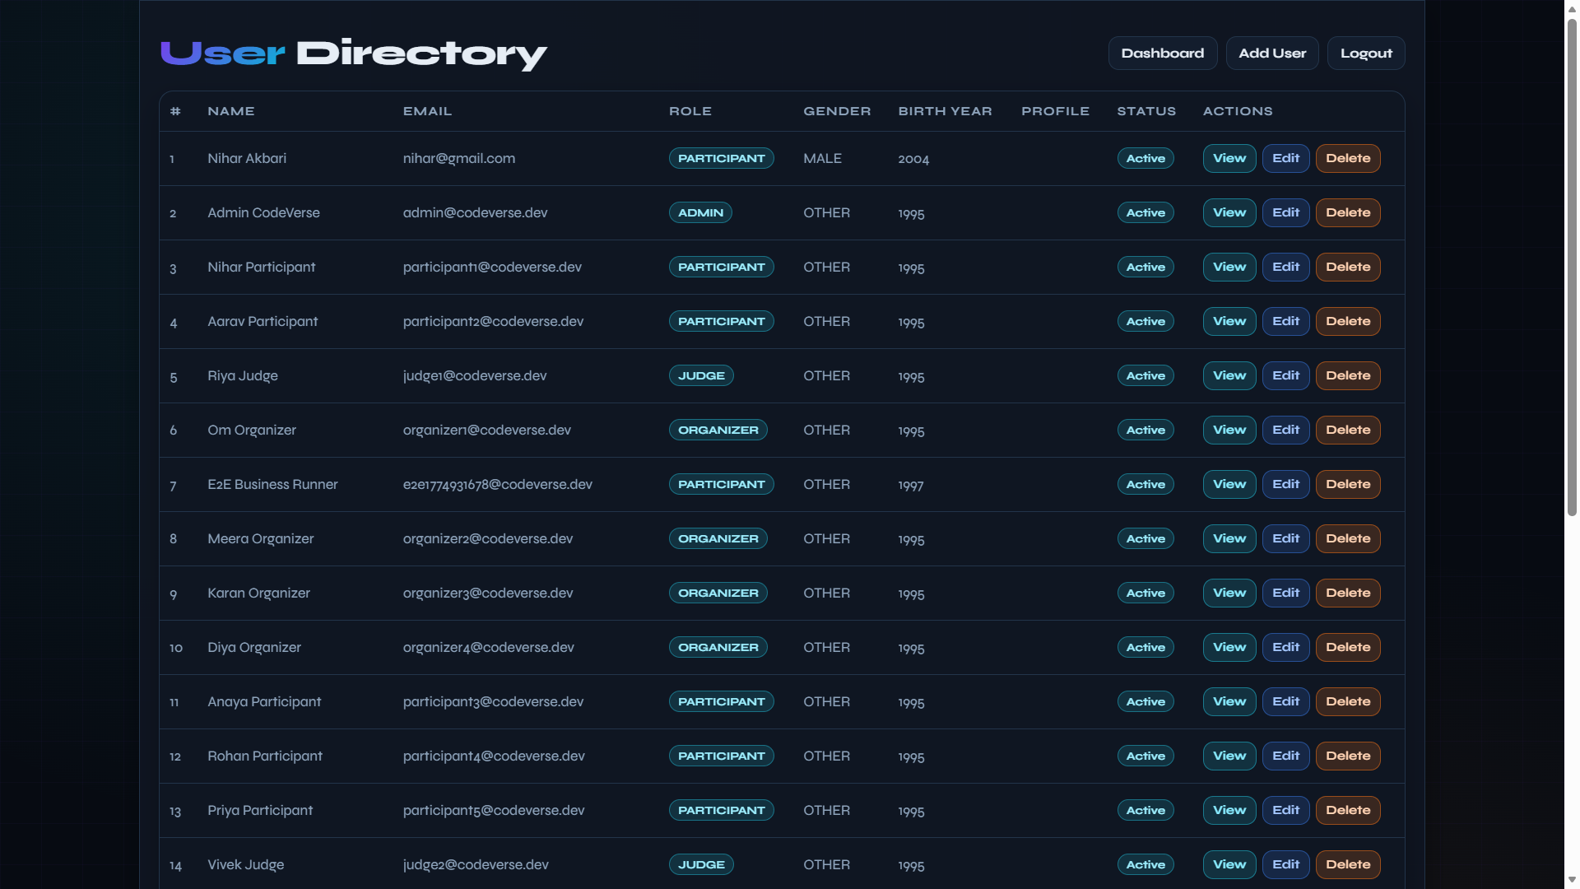
Cont…

Slide 15
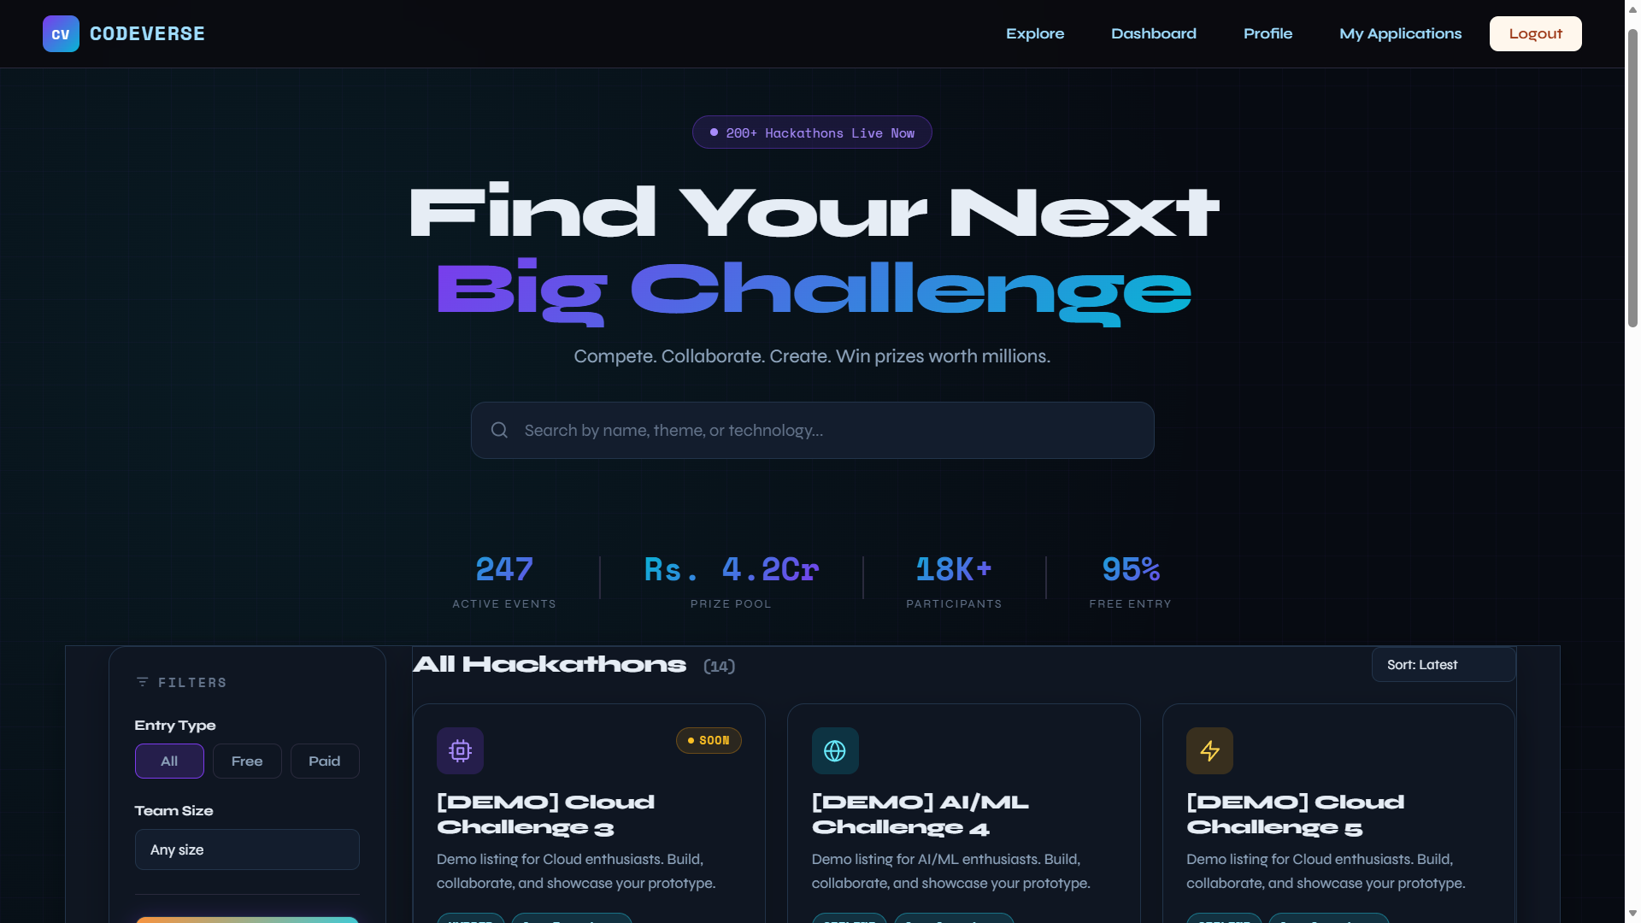
Cont…

Slide 16
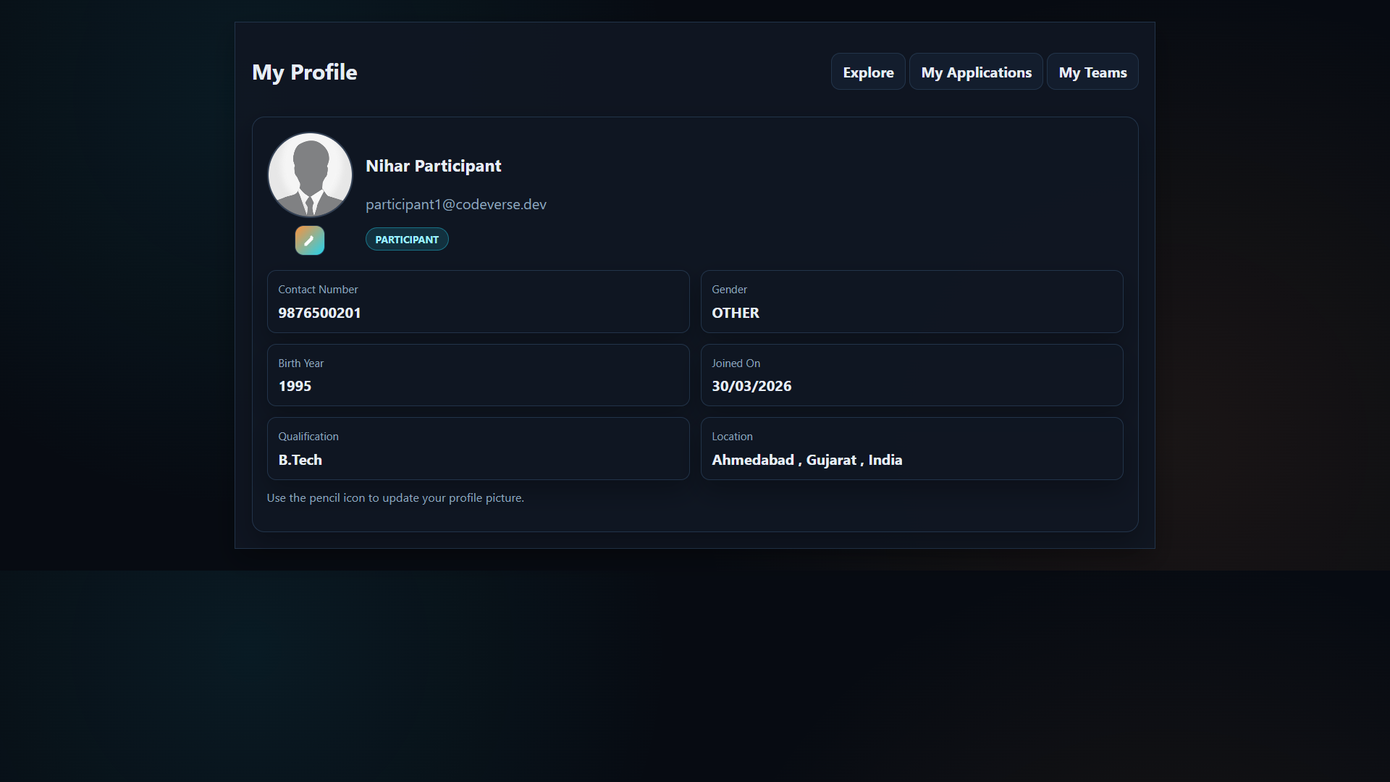
Cont…

Slide 17
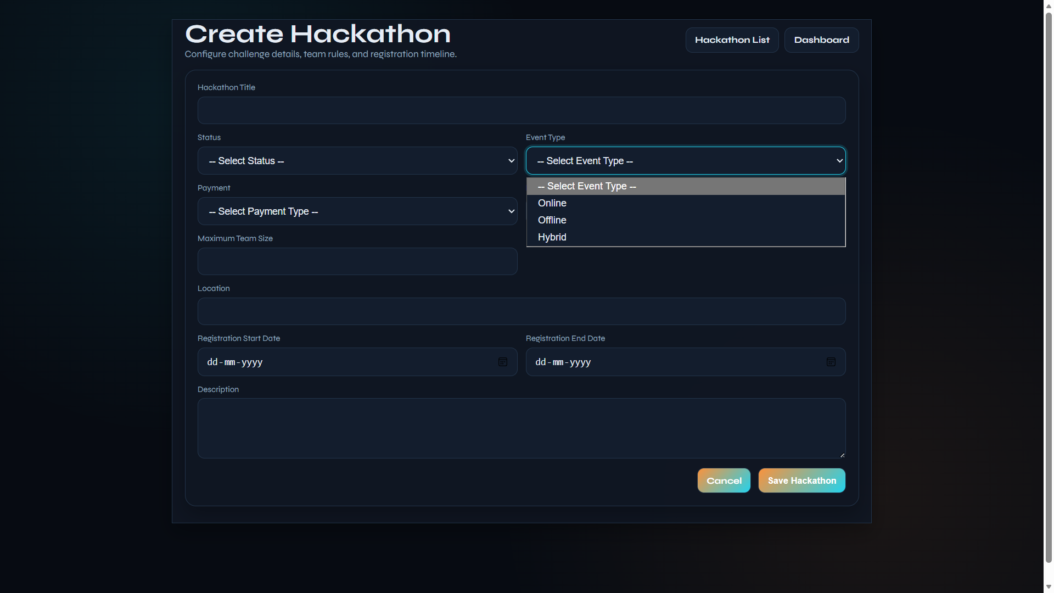
Cont…

Slide 18
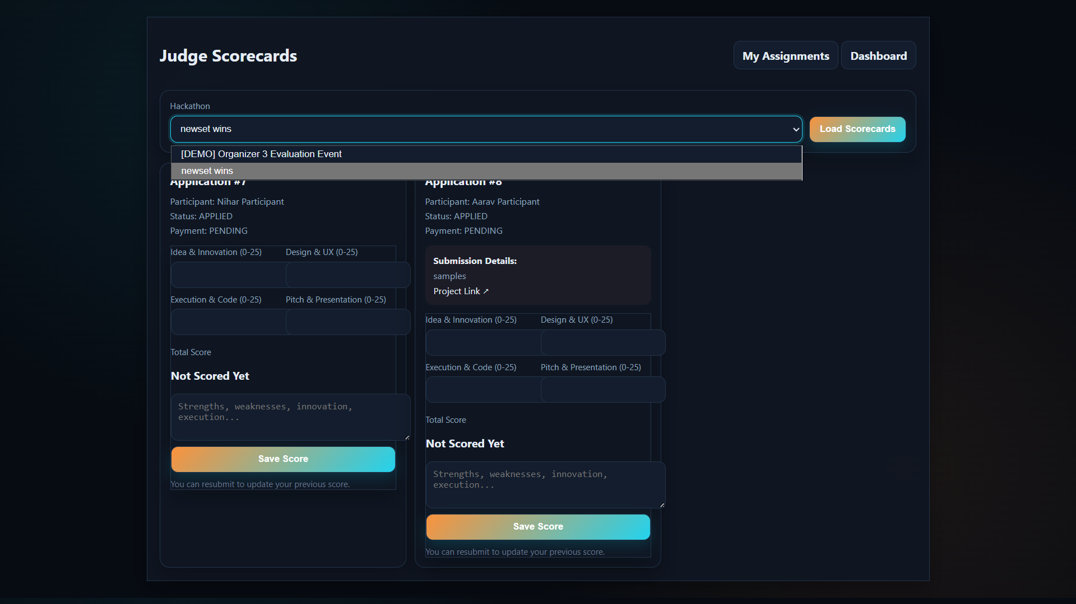
Cont…

Slide 19
10. FUTURE ENHANCEMENT
Add real-time notifications.
Add analytics and reports dashboard.
Add mobile app support.
Add REST APIs for integration.
Add automated email reminders.
Add plagiarism checking for submissions.

Slide 20


